Slide 1

GCIS-124
Software Development & Problem Solving
13: Algorithms

Slide 2

Next Week: Team Project
Some software tasks are too large and complex for an individual software engineer to complete them alone in a reasonable amount of time.
It is usually the case that a team of software engineers will work together on large scale projects.
The team collaborate on all phases of the project.
Design
Implementation
Testing
Working on a team also presents challenges that you will not generally face when working alone.
Including the dreaded merge conflict.
In support of this, you will be working with 2-3 other students on a team project beginning next week.
Next week we will begin the team project. Your instructor will provide details about how your teams will be formed.

Slide 3
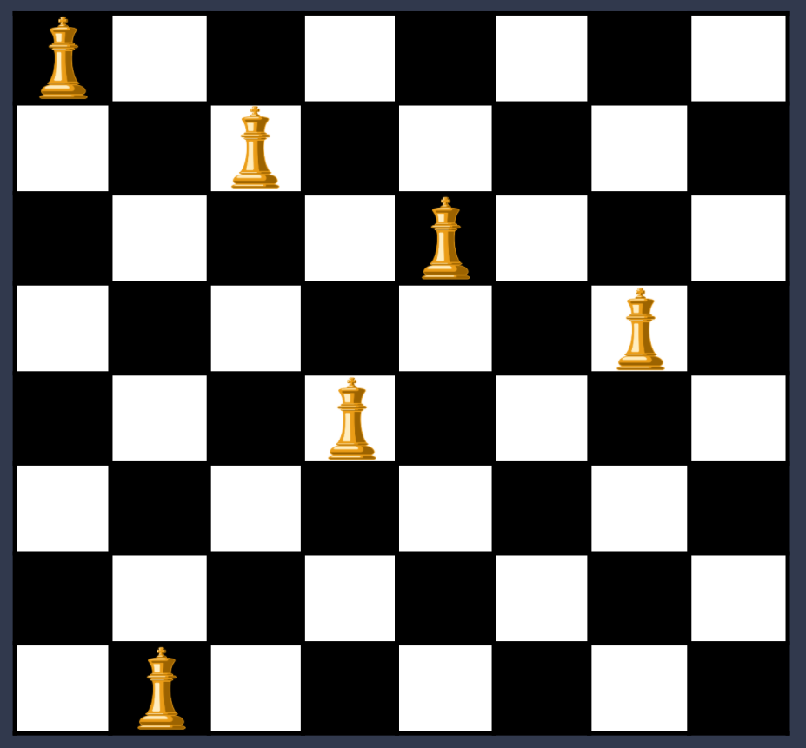

Overview of the Week
We have spent the better part of two semesters implementing a variety of algorithms. In this unit we will spend more time exploring exactly what an algorithm is.
How to apply an algorithmic approach to problem solving.
How to capture algorithms quickly using pseudocode.
A few very well known algorithms in computer science.
Specifically, we will explore:
Algorithms & Pseudocode
Algorithmic Problem Solving
Greedy Algorithms
Change Making
Nearest Neighbor
Dijkstra's Algorithm
Backtracking
To begin, we will focus on an algorithmic approach problem solving, describing algorithms using pseudocode, and greedy algorithms.
We will try to answer questions like "Can I fit 8 queens on an 8x8 chessboard?" and "What is the lowest cost path between two vertices in a weighted graph?"

Slide 4

Algorithms
An algorithm is a finite procedure, written in a fixed symbolic vocabulary, governed by precise instructions, moving in discrete steps, 1, 2, 3, …, whose execution requires no insight, cleverness, intuition, intelligence, or perspicuity, and that sooner or later comes to an end.
When programming in a high-level language like Python or Java, the programmer designs an algorithm.
But what does this mean, exactly?
An algorithm is like a recipe with instructions that tell a computer how to solve a problem.
First, break the problem into discrete steps.
Implement each step as an instruction in a programming language.
Execute the program.
We often begin by writing an algorithm in pseudocode.
We use plain English (or something like it) to describe what it is that we'd like to do.
We then translate that pseudocode into the syntax of our language of choice.
Believe it or not, this is not the creepy killer from Silence of the Lambs, but is actually David Berlinski, the person that wrote The Advent of the Algorithm.

Slide 5
An Algorithmic Approach to Problem Solving
An algorithmic approach to problem solving begins by breaking the problem that we are trying to solve down into a series of discrete steps.
If these steps are executed in the correct order, we will arrive at the solution to the problem at hand.
Ultimately, we would like to capture these steps in a programming language like Python or Java.
But before we start dealing with the rigid syntax of a real programming language, it is often useful to first try to express the algorithm that we wish to write in pseudocode.
Pseudocode is a term for very high-level descriptions of what we would like the computer to do.
The description should be detailed, but is not concerned with the syntax of any particular language.
Most pseudocode is very close to written or spoken language, and there are no rules of grammar or syntax.
The purpose of using pseudocode to describe algorithms is to sketch out an algorithm quickly, without spending time dealing with syntax errors or heavy weight tools like an IDE.
There are no rules to writing pseudocode. The point is to avoid spending time on strict rules of syntax in order to express the algorithm as quickly as possible.
Euclid's Method for finding the Greatest Common Divisor of two integers A and B:
As long as A is not equal to B:
if A is greater than B:
Let A = A - B
otherwise
Let B = B - A
Return A
Here is an example of pseudocode used to represent Euclid's method for finding the GCD of two integers.

Slide 6
13.1
Euclidean Pseudocode
An algorithm is like a recipe that lists the ingredients needed and the steps required to solve a specific problem. We often sketch an algorithm out by first writing pseudocode that describes that we'd like the program to do. Next, the pseudocode needs to be translated into statements in a real programming language. Practice now by implementing Euclid's method for finding the greatest common divisor of two integers.
Create a new Java class named "Euclid" and implement the algorithm depicted to the left as a static method.
Begin by stubbing out the gcd method. It should declare parameters for A and B and return an integer.
Next, capture each of the steps as an inline comment in the method. You must commit this version of your code before moving any further!
Implement each of your comments as a Java statement.
Define a main method with the appropriate signature and test your gcd method with several different combinations of A and B.
Euclid's Method for finding the Greatest Common Divisor of two integers A and B:
As long as A is not equal to B:
if A is greater than B:
Let A = A - B
otherwise
Let B = B - A
Return A

Slide 7
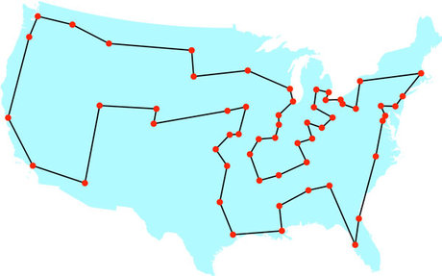
Greedy Algorithms
A greedy algorithm is one that makes a decision based on what appears to be the optimal choice at the time.
“The optimal choice at the time” is another way of saying “the local optimum” - what appears to be the best answer for that particular step in the problem given the information that we have.
Greedy algorithms sometimes produce a result that is the global optimum.
The best possible answer for the problem.
But other times, greedy algorithms relatively efficiently produce a result that is reasonably good in a relatively short amount of time.
There are problems for which the optimal answer takes far too long to compute.
In these cases, a greedy algorithm may produce an answer that is “close enough” in a much shorter amount of time.
Greedy algorithms can be a faster alternative to a more heavyweight algorithm if they produce a result that is good enough.
The traveling salesman problem is a classic example of an algorithm that cannot be solved optimally in a reasonable amount of time.
We will be looking at the traveling salesman problem presently, but first let’s take a look at another classic example: making change.

Slide 8

Making Change
Consider a typical transaction at the grocery store.
A customer approaches a cashier with a cart full of goods.
The cashier scans the merchandise and presents the customer with the total price for all of the goods.
The customer hands over a payment in the form of an amount of cash greater than or equal to the total price.
The cashier gives any change due back to the customer.
There are potentially many algorithms that the cashier might use to determine which coins and bills to use
Try every possible permutation of available coins and bills.
Choose the largest coin or bill that is less than or equal to the amount due, and subtract it from the total. Repeat.
Use the closest whole dollar amount.
Make change only in pennies.
etc.
An optimal solution will meet a few simple goals:
Give the customer the correct change.
Use the smallest number of bills and coins necessary.
Determine the correct answer quickly.
Which algorithm(s) if any meet these goals?
Remember, a greedy algorithm makes the best possible choice at each step with whatever limited information is available.
The algorithm that chooses the largest denomination that is less than or equal to the amount due is an example of a greedy algorithm.
Does it also find the optimal answer?

Slide 9

13.2
Making Change
Now it's your turn to practice writing pseudocode. Sketch out a greedy change-making algorithm using comments before you try to implement it in the next activity.
I would like some beef jerky and a Diet Coke.
Take a few moments to examine the Currency enum that has been provided to you.
Your algorithm should return a List of Currency that sums to the correct amount of change.
For example, if $2.26 was the change due back to the customer, your algorithm should return [DOLLAR, DOLLAR, QUARTER, PENNY]
Create a new Java class named "Greedy" and define a method called "makeChange" that declares double parameters for price and payment. It should return a List of Currency.
The price represents the total cost of the items the customer wants to purchase, and the payment indicates how much money they are paying.
Using inline comments, sketch out a greedy algorithm for computing the correct change to return to the customer in pseudocode.
When you have finished outlining your algorithm, commit your code.
The greedy change making algorithm always picks the biggest denomination that will "fit" and subtracts it from the total.

Slide 10
13.3
Implementing Change
Once you are reasonably certain that you have sketched out a sufficiently detailed change-making algorithm, go ahead and try to implement it in Java. Translate each of your pseudocode comments into one or more Java statements. Does it work?
Thank you for shopping at Crossroads. Your total is $1,347.86.
Open the Greedy class and navigate to the makeChange method.
Implement each of the steps in your algorithm using Java statements.
You should ultimately return a List of Currency.
Define a main method with the appropriate signature.
Test the makeChange method with several combinations of prices and payments.
Print the results of each test to standard output.
The greedy change making algorithm always picks the biggest denomination that will "fit" and subtracts it from the total.

Slide 11

The Knapsack Problem
The greedy change-making algorithm makes a locally optimal decision with each iteration:
"What is the largest bill or coin that is less than the current amount due?"
Such decisions are quick and easy to make, but are based on limited information.
No memory of what has come before.
No idea what is coming next.
Sometimes making the locally optimal decision results in a solution that is also globally optimal.
This is the case with the change-making algorithm, which quickly comes up with the best possible answer.
But this isn't always the case!
Consider the Knapsack Problem.
A knapsack has a maximum weight capacity that it can hold.
Each item has a weight and a value.
What is the best way to maximize the value of the items in the knapsack without going over its weight limit?
There are several possible greedy algorithms for choosing which items should be packed into the knapsack. Do any find an optimal solution?

Slide 12

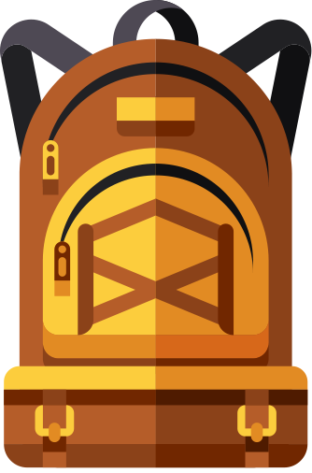


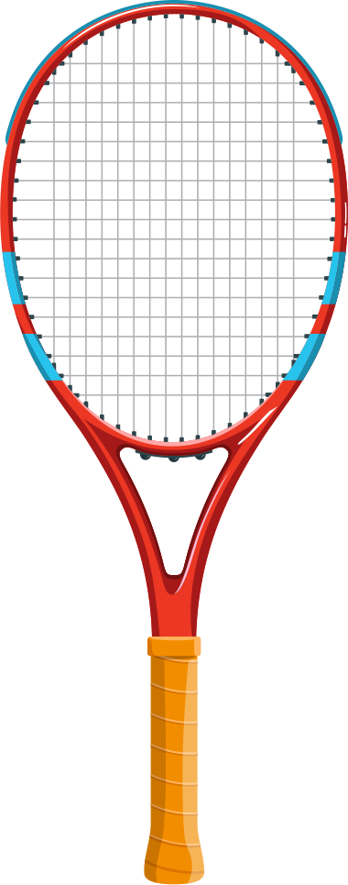

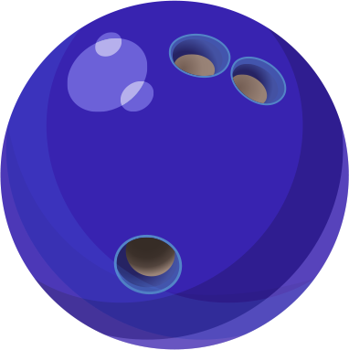
The Illustrated Knapsack Problem
10 lb
A knapsack has a maximum weight capacity that it can carry.
The goal of the Knapsack Problem is to pack the combination of items that maximizes the total value without exceeding the capacity.
And each item has a value and a weight.
$10
10 lb
The optimal solution requires trying every possible combination of items to see which has the highest value; this is computationally expensive.
$1, 1lb
$2, 2lb
$3, 3lb
$4, 4lb
A greedy algorithm quickly chooses the next item based on local optima like lowest weight or highest value.
$5, 9lb
But will the greedy knapsack-packing algorithm guarantee the optimal result?

Slide 13

13.4
Knapsacks and Items
A few classes have been provided to you to help you implement a greedy knapsack-packing algorithm. Examine the classes and then think about your algorithm. What do you think will work best?
Take a few minutes to examine the contents of the knapsack package that has been provided to you:
Item - a class that represents an item including its name, weight, and value. Items are naturally comparable by weight from lightest to heaviest.
ValueComparator - a comparator that arranges items from highest to lowest value. In the event that two items have the same value, they are compared by weight.
Knapsack - implements a knapsack. An item can be packed as long as its weight does not exceed the maximum capacity. The knapsack keeps track of items packed, current load, and total value.
ItemSets - provides helper methods to return pre-made sets of items that can be used for testing a knapsack-packing algorithm.
Use this time to ask any questions that you have about the code.
When you are finished, start thinking about the greedy algorithm that you want to write to pack a knapsack.
How will you choose the next item to pack?
Will you need to write your own Comparator?
How easy do you think it will be to foil your algorithm?
Notes:
The first part here should be a class activity - take a few minutes to go through the code with your students.

Slide 14

13.5
Packing the Knapsack
Using only pseudocode, sketch out your algorithm. Try to write one descriptive sentence or phrase for each statement you think that you will need to write.
Open the Greedy class and define a new method named "packItems" that declares parameters for a Knapsack and a List of items.
Using only inline comments, sketch out your plan for a greedy algorithm to solve the Knapsack-Packing algorithm using pseudocode.
What local optima will your algorithm consider as it chooses the next item to try to pack?
You should remove items from the list as they are packed (or discarded).
How will your algorithm know when to stop?
When you have finished your pseudocode algorithm commit your code to your repository.

Slide 15
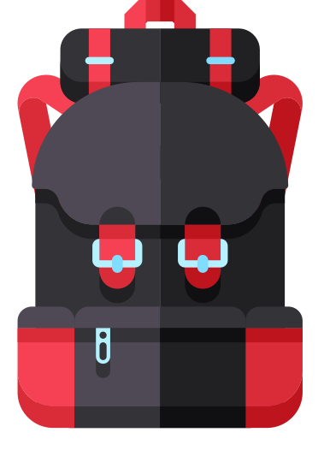
13.6
Knacking the Packsack
Now it's time to put your algorithm to the test! Implement the greedy algorithm that you sketched out previously. How does it compare to the optimal solution for each item set?
Open the Greedy class and implement your knapsack-packing algorithm in the packItems method.
Remember to remove items from the list as they are packed.
The Knapsack will not allow an Item to be packed if its weight exceeds the capacity.
Print the Knapsack once it is packed.
Navigate to main and create a Knapsack with a capacity of 10 pounds. Test your knapsack-packing algorithm using the premade item sets created by the ItemSets class.
The Sports Set
The Electronics Set
The Toy Set
The Metal Set
How does your algorithm compare to the optimal solution for each?

Slide 16

The Traveling Salesman Problem
A traveling salesman would like to travel to 50 different cities in the contiguous United States.
All 50 cities are connected to each other by the interstate highway system.
Meaning that the salesman can travel from any one city to any other.
The salesman would like to plan a trip with a few goals in mind:
He would like to visit each of the 50 cities exactly once.
In order to save on time, money, and gas, he would like to minimize the total distance traveled.
The optimal solution to this problem would require mapping every possible route through all 50 cities.
There are 50! possible routes!
A greedy algorithm would attempt to plan a trip based on some local optima such as which cities are closest to each other or in the same general direction.
Before we can begin implementing an algorithm to find a solution to the Traveling Salesman Problem, we will need to find a way to represent the 50 cities and the distance between them.
Would it be possible to use a graph?

Slide 17
A Weighted Graph
We could make a graph to represent the 50 cities.
Each city would be a vertex in the graph.
Each city would also be connected to the other 49 cities as neighbors.
We could then run a BFS or DFS search to find a path through all 50 cities.
The problem is that our graphs do not have any concept of cost or distance between two cities.
There is no way to tell the difference between a neighbor city that is 10 miles away, and one that is 3,000 miles away!
Meaning the BFS or DFS will be very unlikely to minimize the distance traveled.
We will need a modified version of our graph data structure that assigns values to the edges between vertices.
We will refer to these values as weights.
Our weighted graph will also need modified versions of our search algorithms that take edge weights into consideration.
In this problem, the number of vertices in the path does not change: it will always be exactly 50.
What will change (hopefully) are the specific edges along the path such that the total distance traveled is minimized.

Slide 18
A Weighted Graph
The search algorithms that we have looked at so far do not differentiate between neighbors...
A
2
D
If BFS were looking for a path from A to E, it would find one with the fewest edges, for example...
7
6
1
6
5
F
C
2
B
5
But the total cost of this path is 6 + 5 + 4 = 15.
2
4
5
4
G
4
E

Slide 19
A Weighted Graph
But there is a lower cost path from A to E in this graph.
A
2
D
The Path A-C-B-G-E comprises four edges but has a total cost of only
1 + 2 + 2 + 4 = 9.
7
6
1
6
1
5
F
2
5
C
2
B
BFS would never find this path because it always finds paths with the fewest edges.
2
2
4
5
4
DFS might find it, but if it did, it would be a total coincidence.
4
G
4
E

Slide 20
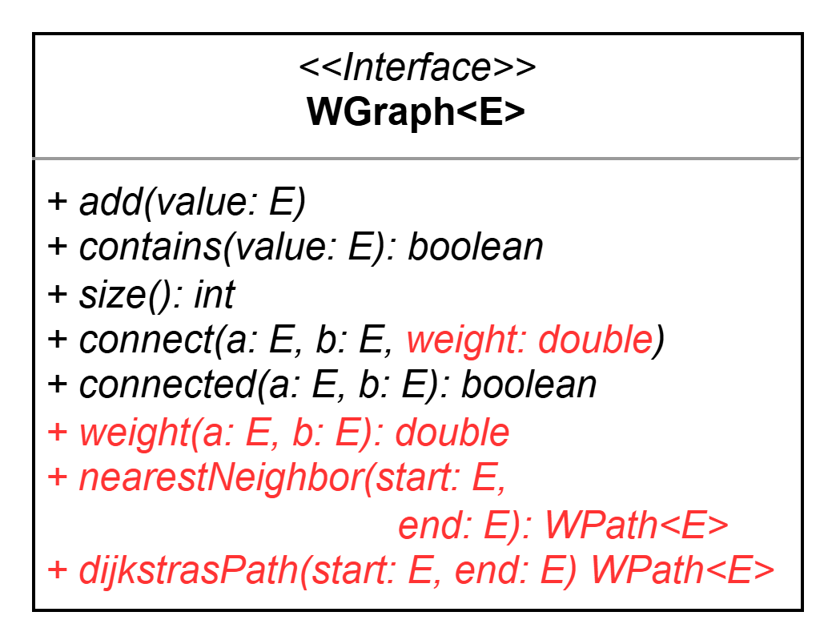
13.7
A Weighted Graph
The Graph abstract data type that we have used previously keeps track of which vertices are connected as neighbors, but it doesn't assign a weight to those connections. We'll need a new Graph data structure that stores edges with weights.
The WGraph interface has been provided to you in the weighted package.
Take a moment to review the code and the methods that it provides. Do you understand the purpose of each one?
If you have any questions, ask your instructor!
We will be discussing the Nearest Neighbor and Dijkstra's Path algorithms presently.
When two vertices are connected by an edge in a weighted graph, a weight is associated with the edge.

Slide 21
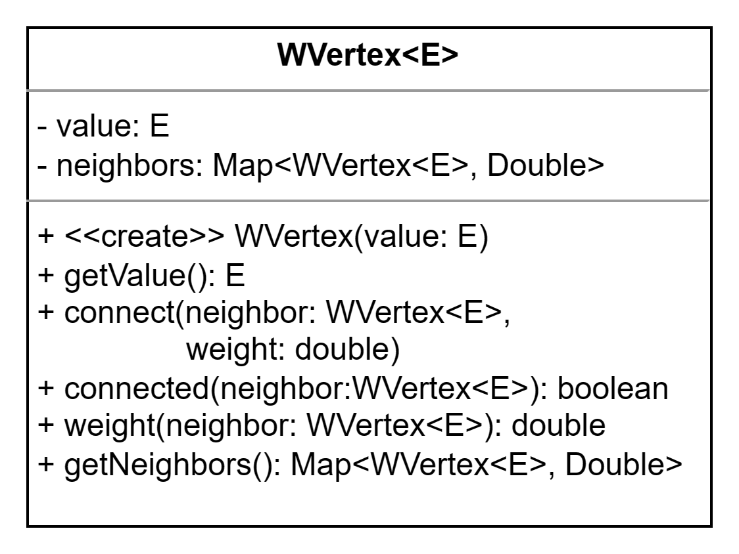
13.8
A Weighted Vertex
A weighted adjacency graph needs a special vertex that not only keeps track of its neighbors, but the weight of the edges to those neighbors. Take a moment to examine the WVertex class that has been provided to you in your repository.
Open the WVertex class that has been provided to your in your repository for this unit.
Examine the fields and the constructor.
Examine each of the methods that the WVertex provides. Do you understand the purpose?
If you have any questions, raise your hand!

Slide 22
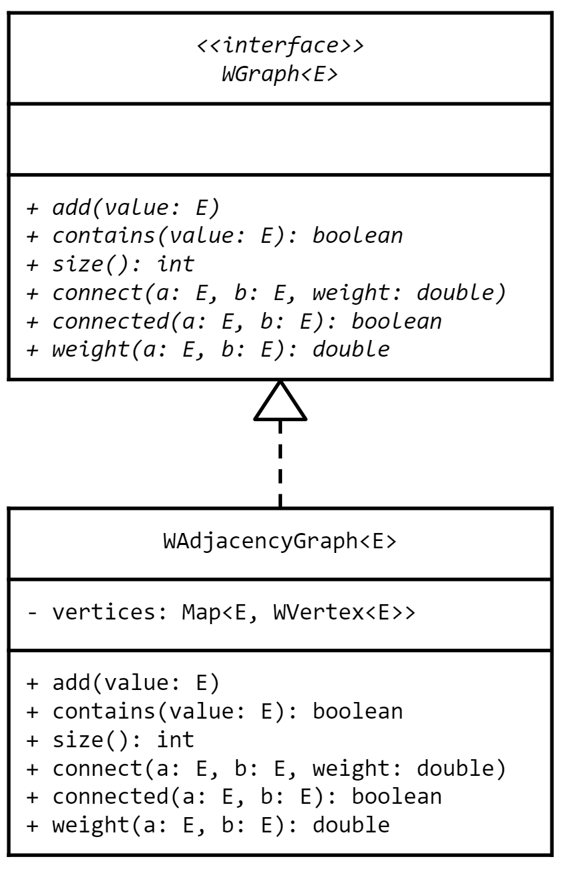
13.9
A Weighted Adjacency Graph
Now it's finally time to work with a weighted graph! The implementation is very close to the AdjacencyGraph, so the implementation has been provided to you. Spend a few moments looking through the code with your instructor.
Open the WAdjacencyGraph that has been provided to you in the weighted package.
Together with your instructor, examine the code and ask any questions that you have.

Slide 23
13.10
Building a Map
When using a graph to solve problems, the challenge usually lies in constructing the graph properly so that you can use it to run the correct algorithms, e.g. BFS or DFS. Create a new class to build a graph that represents a map of 50 cities in the contiguous United States.
You will be creating a weighted graph of cities. Before you get started, open the City class that has been provided to you in the unit13 package.
Together with your instructor, examine the class.
Raise your hand if you have any questions.
Next, open the uscities.csv file that has been provided to you in the data directory of your repository.
Note that each city includes a name, state, latitude, and longitude.
Google the latitude and longitude of your hometown and add it to the bottom of the file. If your hometown is already in the file, use Rochester instead.
Create a new class in the unit13 package named MapMaker.
Define a static method named buildMap that declares a parameter for a filename. Build a weighted adjacency graph of the cities in the specified in the file.
Define a main method with the appropriate signature and use the uscities.csv file to build a map of cities in the US.
City,State,Latitude,Longitude
Birmingham,Alabama,33.5207,-86.8025
Phoenix,Arizona,33.4484,-112.0740
Little Rock,Arkansas,34.7465,-92.2896
Los Angeles,California,34.0522,-118.2437

Slide 24
Nearest Neighbor
As was previously mentioned, the optimal solution for the Traveling Salesman problem requires an exhaustive search of all possible paths through the graph.
This would take a while as there are are 50! possible paths.
A greedy algorithm might not find the optimal path, but it should find one that is reasonably good in a much shorter amount of time.
One such algorithm is the Nearest Neighbor algorithm.
Choose a starting point in the graph, e.g. the city closest to the salesman's current location.
Each time the salesman chooses a new city to travel to, he chooses the closest city that he has not yet visited.
This continues until all 50 cities have been visited.
Each time a new city is chosen, the algorithm heads deeper into the graph without looking at any other neighbors.
Does this sound familiar?
The Nearest Neighbor algorithm is a slight modification of a depth-first search; it always chooses the neighbor connected by the edge with the lowest weight.
A
2
D
6
7
1
C
2
B
5
F
4
5
4
G
4
E
But will it always find the path with the lowest cost?

Slide 25
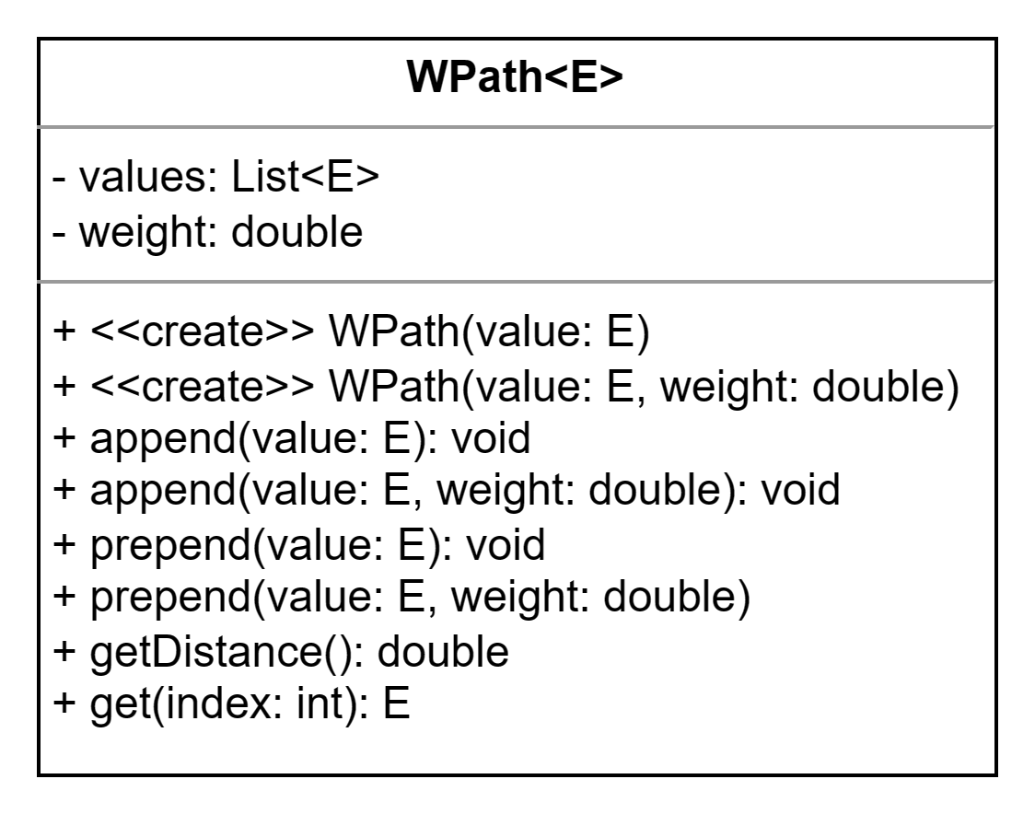
13.11
A Weighted Path
The Nearest Neighbor algorithm will not only need to return the values in a path, but the total distance (the sum of the weights of all of the edges on the path) as well. The WPath class has been provided to you to fulfill this function.
Open the provided WPath class in the weighted package.
Examine each of the methods to gain an understanding of what it does.
Notice that there are overloaded constructors that can be used to create a path with or without an initial weight.
Notice also that values can be added to either end of the path with or without a weight.
If you have any questions, ask!

Slide 26

Sorting Neighbors
(Information Expert)
In order to properly implement the Nearest Neighbor algorithm in a weighted graph, we will need to be able to iterate through each vertex's neighbors in order based on distance from shortest to longest.
This means that we will need to implement a method that creates a sorted list of neighbors.
Where should this method be implemented?
Information Expert is an object-oriented design principle that is also sometimes called "behaviors follow state."
This means that, if you need to add a new method (behavior) to existing code, you should add it to the class that already contains the necessary data (state).
Which class in the system already contains all of the information necessary to sort a vertex's neighbors based on their distance from the vertex?
Information Expert is one of the GRASP design principles that were first cataloged by Craig Larman, one of the pioneers of the software engineering discipline.

Slide 27
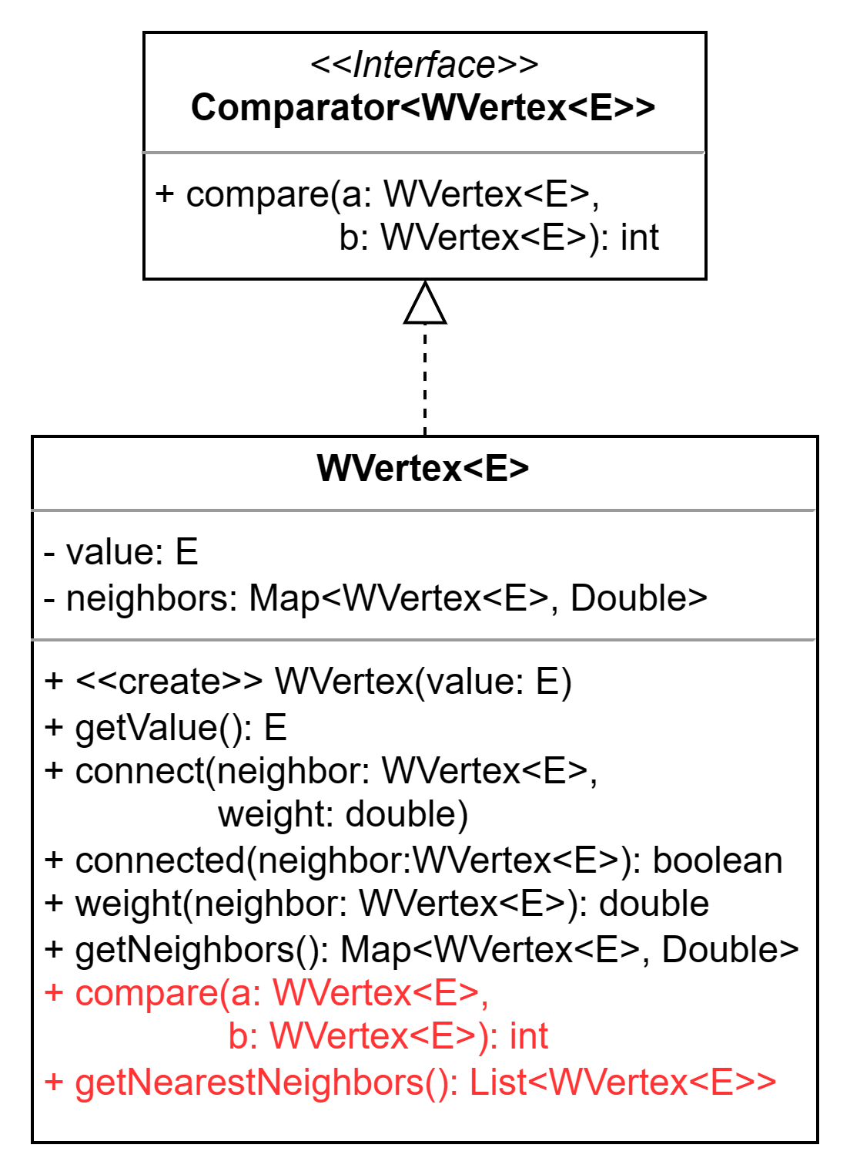
13.12
Sorting Neighbors
In order to implement Nearest Neighbors, we'll need to be able to create a sorted list of neighbors based on their distance from a vertex from shortest to farthest.
The WVertex will need to compare its neighbors based on their distance (the weight of the edge). Open the class and update it so that it implements Comparator.
The compare method should compare two neighbors, a and b, based on their distance from the vertex.
Hint: use the map of vertices to look up the weight of each vertex and then return -1 if a < b, and +1 otherwise.
Next, define a new method named "getNearestNeighbors" that creates a list of neighbors and sorts it before returning it.
Use the neighbors.keySet() method to copy the neighbors into a list.
Use Collections.sort(list, this) to use the vertex as the comparator that helps sort its neighbors in the list.
Add a new test method to the WVertex class that you can use to test the new method.
In the setup add at least three neighbors with different weights.
The information expert principle states that we should add new methods to an existing class that has the needed data.

Slide 28
13.13
Nearest Neighbor, Part 1
Nearest Neighbor is a greedy algorithm that attempts to quickly find a path through a graph that has a relatively low cost. It does this by choosing neighbors based on their distance from the current vertex. Begin Implementing it in your weighted graph now!
A
2
D
The Nearest Neighbor algorithm is a modified DFS. Begin by opening the provided AdjacencyGraph class and copying the visitDFPath method.
Open the WAdjacencyGraph class and paste the method at the bottom of the class.
Rename it to "visitNearestNeighbor".
Make sure to return a WPath instead of a List!
Modify the for loop so that it iterates over the nearest neighbors.
If a non-null path is returned, prepend the vertex and its weight onto the path!
Make sure that there are no PROBLEMS in your code.
6
7
1
C
2
B
5
F
4
5
4
G
4
E

Slide 29
13.14
Nearest Neighbor, Part 2
We're not done implementing Nearest Neighbor yet! Finish implementing and testing the method in your weighted graph now.
Open the provided AdjacencyGraph class and copy the dfPath method.
Open the WAdjacencyGraph class and paste the method at the bottom of the class.
Rename the method from "dfPath" to "nearestNeighbor". You will also need to update the code to use a WPath instead of a list.
Use the provided NearestNeighborTest to test your algorithm.
A
2
D
6
7
1
C
2
B
5
F
4
5
4
G
4
E

Slide 30
13.15
Traveling Neighbors
Let's see how Nearest Neighbor does when finding a path between two cities in the contiguous United States.
Open the MapMaker and navigate to the main method.
Use Nearest Neighbor algorithm to find a path from Boston, Massachusetts to Los Angeles, California and print it to standard output.
How does Nearest Neighbor find a path from coast to coast in the United States?

Slide 31
Review: Graphs & Searches
A graph comprises vertices, each of which contains a value of some kind.
Two vertices can be connected by an edge.
Edges may be directed or undirected.
An edge may or may not have a weight that indicates the cost of traversing the edge.
Two vertices connected by an edge are said to be neighbors.
A path is the series of edges that connect two vertices together.
A search is an algorithm that determines whether or not a path exists between two vertices.
Some search algorithms consider the weight of the edge between vertices.
Breadth-First Search and Depth-First Search ignore the cost of edges.
Nearest Neighbor always chooses the unexplored edge with the lowest cost.
2
A
D
6
7
1
C
2
B
5
F
2
5
4
G
4
E
Different searches will find different paths through a graph. Some look for fewer edges while others look for lowest cost.

Slide 32
What does "Shortest" Mean?
A breadth-first search will always find a path that has the fewest possible edges.
There may be more than one path with the same "shortest" length.
BFS will find one based on the order in which it visits the neighbors of each vertex.
A depth-first search will only find a path with the fewest edges by coincidence.
Again, this will be determined by the order in which the search visits the neighbors of each vertex.
DFS is just as likely to find the path with the most edges.
Neither algorithm is guaranteed (or even likely) to find the path with the lowest total cost.
We also refer to total cost as total distance and the lowest cost as the shortest distance.
If the shortest distance path has more edges, BFS will never find it.
DFS may find it, but only by coincidence.
Nearest Neighbor is a greedy algorithm that chooses the unexplored neighbor with the lowest cost, but is not guaranteed to find the lowest cost path.
A
2
D
6
7
1
C
2
B
5
F
4
4
5
G
4
E
The definition of "shortest" depends on the problem that you are trying to solve. Is it the fewest hops or lowest cost?
Next, we will focus on finding the path with the lowest cost even if it means that it includes more edges.

Slide 33
Dijkstra's Algorithm
An optimal path P between two vertices S and E comprises edges that may be numbered from 0 to N.
Let P' be the subpath of P that comprises the edges numbered 0 to N-1 that ends at some vertex E'.
That is the subpath that contains all but the last edge of P ending at the last vertex before E.
If P is optimal, then it must be true that P' is also optimal.
That is to say that there cannot be some other path from S to E' that is shorter than P'.
If there were such a shorter path, then P could not be optimal.
It must also be true that the path P'' that comprises the edges 0 to N-2 and ends at vertex E'' is also optimal.
And so on.
OK, so what?
If we can methodically work through the graph and keep track of the shortest path from S to every other vertex, we can find all of the shortest paths!
If debugging is the process of removing bugs, then programming must be the process of putting them in.
His last name is pronounced like “Dike-stra.”

Slide 34
Dijkstra in a Nutshell
Assume that you are trying to find the optimal path from S to E in a weighted graph.
Now assume that there are exactly two possible paths from S to E' the total distance of which are Q and R.
Therefore, we can find the optimal path by finding the optimal subpaths from S to every vertex that is along the path to E.
The second to last vertex on that path is E' and the distance between E' and E is C.
If Q < R, then Q+C < R+C. Therefore,
the optimal path from S to E must include Q and not R.
Q
S
E'
C
E
R

Slide 35
An Illustrated Example
Let's represent a path from X to Z in the form X_{d}Y_{d}Z where d is the distance between each pair of vertices.
2
A
D
When searching for a path from A to E, Nearest Neighbor found the path A₁C₂B₄G₄E with a total cost of 11.
7
1
6
Dijkstra observed that if A₁C₂B₄G₄E is optimal, then all of its subpaths must also be optimal. Which means that the subpath A₁C₂B₄G must be the optimal path from A to G. Is that true?
5
F
C
2
B
4
5
4
It is not! There is a shorter path from A to G: A₁C₅G with a total cost of 6.
G
4
E
It is impossible for A₁C₂B₄G₄E to be optimal if it contains a subpath that is not optimal. In fact, the optimal path is A₁C₅G₄E with a total cost of 10.

Slide 36
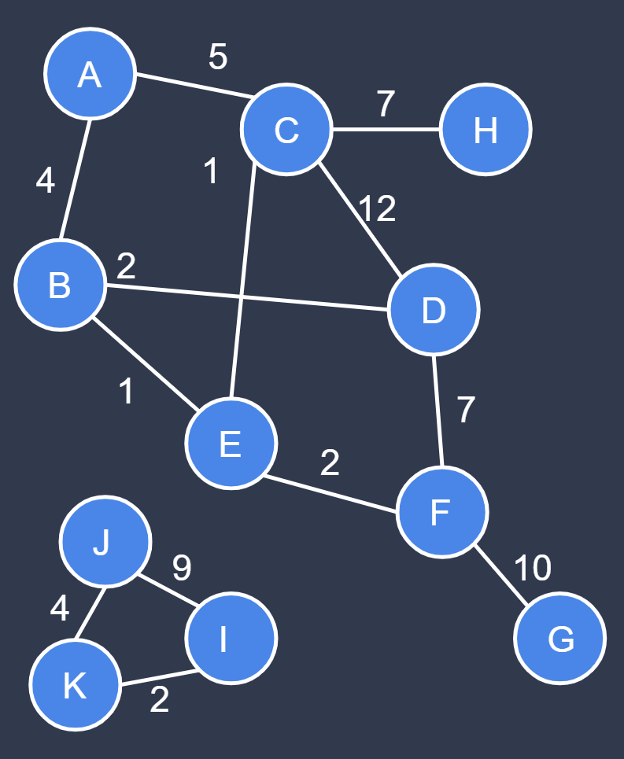
Search Fight!
Consider searching for a path from A to G in the weighted graph to the left.
The Breadth-First Search algorithm would visit each vertex in order based on distance from the start.
All vertices that are one edge from start, then vertices that are two edges, and so on.
In order to remain consistent, given the choice between two unexplored vertices, we choose the one that comes first alphabetically.
The path the BFS would find is therefore A₄B₂D₇F₁₀G with a total cost of 23.
Depth-First Search chooses one unexplored neighbor and heads deeper into the graph.
For consistency we also choose the neighbors in alphabetical order.
The path that DFS would find is therefore A₄B₂D₁₂C₁E₂F₁₀G with a total cost of 31.
Nearest Neighbor would find the path A₄B₁E₁C₁₂D₇F₁₀G with a total cost of 35!
None of our algorithms find the optimal path, which is A₄B₁E₂F₁₀G with a total cost of 17.

Slide 37
A Path Tuple
When we implemented breadth-first search we used a map to keep track of each vertex V and its predecessor.
The predecessor was always the vertex through which we first discovered V as a neighbor.
This is one way that BFS ensures that the paths that it finds will have the fewest edges.
But BFS ignores the cost of the edges between neighbors.
We have already seen that it will not find the lowest cost path much of the time.
Simply keeping track of the predecessor vertex will not be sufficient; we also need to know the total distance from the starting vertex through that predecessor.
This means that we will need a new class to store both pieces of information: a path tuple.
These tuples will be stored as the values in a map with each vertex as a key.
The starting vertex will begin with a null predecessor and a distance of 0, e.g. (null, 0)
All other vertices will begin with a null predecessor and a distance of infinity, e.g. (null, ∞)
Vertex | Path Tuple
A | (null, 0)
B | (null, ∞)
C | (null, ∞)
D | (null, ∞)
E | (null, ∞)
F | (null, ∞)
G | (null, ∞)
As the algorithm runs and each vertex is discovered (or rediscovered), the values in the path tuples will be updated to reflect the predecessor vertex and shortest known distance from start.

Slide 38
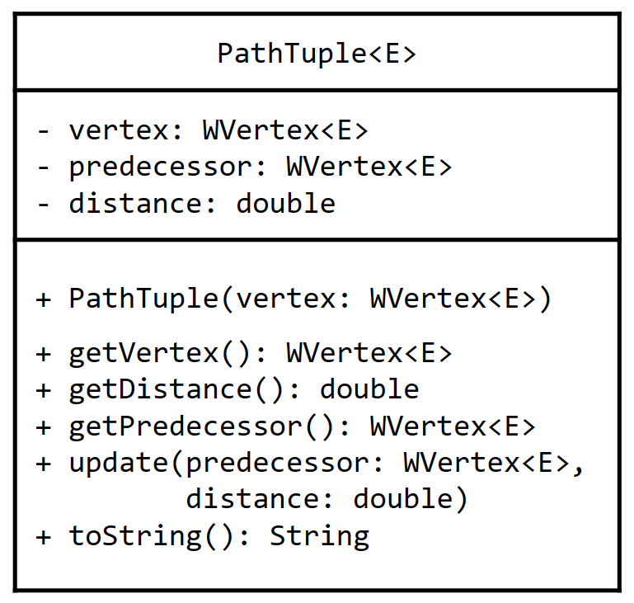
13.16
The Path Tuple
In order to keep track of the shortest distance to each vertex, we will need a path tuple class. This class will keep track of a vertex, its predecessor, and the currently know shortest distance from the start vertex. We will update the predecessor and distance as we find new, shorter paths.
Open the PathTuple class that has been provided to you in the weighted package.
A PathTuple has three essential pieces of information:
A vertex.
Its predecessor.
The currently known shortest distance from the starting vertex.
Note that the constructor:
Sets the predecessor to null.
Sets the distance to Double.POSITIVE_INFINITY.
Note that the update method will ignore the update if the updated distance is not less than the current distance.
If you have any questions, raise your hand!

Slide 39
A Priority Queue
The search algorithms that we have implemented so far all have different ways of choosing which vertex is next.
BFS chooses the next vertex from a queue.
DFS chooses any unexplored neighbor of the current vertex.
Nearest Neighbor chooses the neighbor with the shortest distance from the current vertex.
Dijkstra's Algorithm has its own way of choosing the next vertex: it will always choose the vertex that has the shortest distance from the starting vertex.
Remember, each vertex has a path tuple that keeps track of its predecessor and the total distance from the starting vertex.
We'll use this information to pick the next closest vertex each time.
We will need a data structure to store the path tuples in such a way that we can find the next closest one.
This sounds like a priority queue of path tuples!
PRIORITY QUEUE
A:(null, 0)
E:(null, ∞)
F:(null, ∞)
B:(null, ∞)
K:(null, ∞)
J:(null, ∞)
H:(null, ∞)
C:(null, ∞)
D:(null, ∞)
G:(null, ∞)
I:(null, ∞)
To begin with, the only vertex with a distance that is less than infinity is the starting vertex, and so it will always be returned first.

Slide 40
Unfortunately...Java's Priority Queue Won't Work
Java's PriorityQueue internally uses an array-based heap to arrange the values in priority order.
As you know, a heap arranges values into priority order as they are added to the heap.
To start, all but one of the tuples has a distance of infinity meaning that they have the same priority.
A:(null, 0) | F:(null, ∞) | H:(null, ∞) | D:(null, ∞) | J:(null, ∞) | C:(null, ∞) | G:(null, ∞) | B:(null, ∞) | I:(null, ∞) | E:(null, ∞) | K:(null, ∞)
front
As Dijkstra's Algorithm runs, the values of some of the tuples in the heap will be removed...
...and others will be updated with new values for the shortest known distance from the starting vertex.
As the tuples change, the heap will not automatically rearrange them into priority order. And so they will dequeue in the wrong order.
A:(null, 0) | F:(null, ∞) | H:(null, ∞) | D:(null, ∞) | J:(null, ∞) | C:(null, ∞) | G:(null, ∞) | B:(null, ∞) | I:(null, ∞) | E:(null, ∞) | K:(null, ∞)
C:(A, 5)
B:(A, 4)
front
front

Slide 41
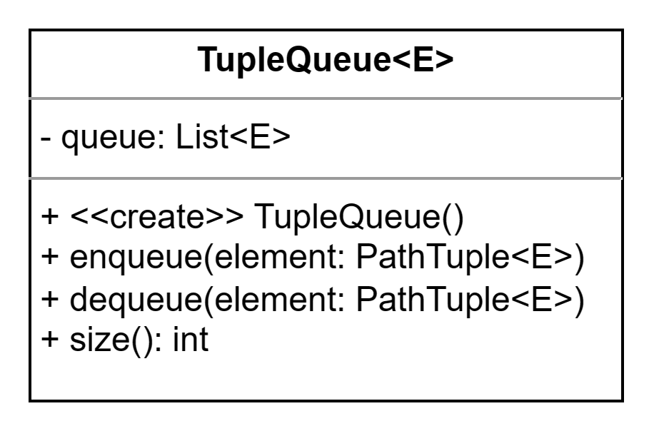
13.17
The Tuple Queue
Unfortunately, Java's PriorityQueue will not rearrange values if/when they change while already inside of the queue. We'll need to use our own (and find tuples using a linear search). Examine the code now.
Open the "TupleQueue" class that has been provided to you in the weighted package.
PathTuple elements are stored in a linked list.
The enqueue method adds elements at the back.
The dequeue method performs a linear search for the PathTuple with the shortest distance from the start vertex.
If you have any questions, raise your hand!

Slide 42
Step 1: Setup
The setup of Dijkstra's Algorithm requires two different data structures.
Vertex | Path Tuple
A | (null, 0)
B | (null, ∞)
C | (null, ∞)
D | (null, ∞)
E | (null, ∞)
F | (null, ∞)
G | (null, ∞)
A
2
D
The first is a map to keep track of every vertex in the graph and its path tuple. The vertices are the keys.
6
7
1
C
2
B
5
F
The path tuple for the start vertex has a null predecessor (because there isn't one) and a distance of 0 (to itself).
4
5
4
G
4
E
Every other vertex in the graph has a null predecessor and a distance of infinity (because we don't know yet).
PRIORITY QUEUE
A:(null, 0)
C:(null, ∞)
B:(null, ∞)
All of the path tuples are also placed into a priority queue.
D:(null, ∞)
F:(null, ∞)
E:(null, ∞)
G:(null, ∞)

Slide 43
13.18
Step 1: Setup
Dijkstra's Shortest Path is probably the most complex algorithm that we will examine in this entire course. Let's take is slowly by examining it in relatively small pieces, one at a time. As usual, the algorithm begins by creating the necessary data structures.
And...we're off!
Open the WAdjacencyGraph class and navigate to the dijkstrasPath method. Together with your instructor, examine the first part of the algorithm: step 1: setup.
It uses the start and end values to retrieve the corresponding vertices.
It creates a Map to store WVertex keys and PathTuple values.
It creates a TupleQueue.
It iterates over the vertices in the graph (including the start vertex):
Makes a new PathTuple for the vertex.
Adds both to the Map.
Adds the tuple to the TupleQueue.
After the initial setup is complete, it fetches the PathTuple for the start vertex from the map and updates it to a distance of 0.
If you have any questions, raise your hand!.

Slide 44
Step 2: The Main Loop
Next, the main loop begins. The path tuple with the shortest distance from start is removed from the tuple queue.
Vertex | Path Tuple
A | (null, 0)
B | (null, ∞)
C | (null, ∞)
D | (null, ∞)
E | (null, ∞)
F | (null, ∞)
G | (null, ∞)
A
2
D
6
7
1
(this should be the start vertex first)
C
2
B
5
F
The idea is that, if every other vertex still in the queue is farther away, then we must already know the optimal path to this vertex.
4
4
5
G
4
E
In other words, there can't be a shorter path through another vertex that is farther away.
A:(null, 0)
PRIORITY QUEUE
A:(null, 0)
C:(null, ∞)
B:(null, ∞)
D:(null, ∞)
F:(null, ∞)
Let's call this vertex V.
E:(null, ∞)
G:(null, ∞)

Slide 45
Step 2: The Main Loop
Next, we look at each of V's neighbors N and we compute the distance from the start to N through V.
Vertex | Path Tuple
A | (null, 0)
B | (null, ∞)
C | (null, ∞)
D | (null, ∞)
E | (null, ∞)
F | (null, ∞)
G | (null, ∞)
A
2
D
6
7
(A, 6)
1
That distance is the sum of the distance in V's path tuple and the weight of the edge between V and N.
(A, 1)
2
B
5
F
C
(A, 2)
4
4
For example, the distance from the start to B through A is the distance in A's path tuple (0) plus the weight of the edge between A and B (6): 0 + 6 = 6
5
G
4
E
A:(null, 0)
If this distance is shorter than the distance currently in N's path tuple, then the path tuple is updated with the new distance and V as the predecessor of N.
PRIORITY QUEUE
B:(null, ∞)
A to B = 0 + 6 = 6
A to C = 0 + 1 = 1
A to D = 0 + 2 = 2
C:(null, ∞)
B:(A, 6)
D:(null, ∞)
C:(A, 1)
D:(A, 2)
F:(null, ∞)
E:(null, ∞)
G:(null, ∞)

Slide 46
Step 2: The Main Loop
Vertex | Path Tuple
A | (null, 0)
B | (A, 6)
C | (A, 1)
D | (A, 2)
E | (null, ∞)
F | (null, ∞)
G | (null, ∞)
We continue to repeat this process, removing the V with the shortest distance from the tuple queue...
A
2
D
6
7
(C, 3)
1
...computing the distance to each of its neighbors N through V...
5
F
C
2
B
(again, this is the distance in V's path tuple plus the weight of the edge between V and N)
4
4
5
G
4
E
If the computed distance is shorter than the distance already in N's path tuple, then the path tuple is updated with the new distance and V as the predecessor.
(C, 6)
C:(A, 1)
PRIORITY QUEUE
B:(A, 6)
C to A = 1 + 1 = 2
C to B = 1 + 2 = 3
C to G = 1 + 5 = 6
C:(A, 1)
B:(C, 3)
D:(A, 2)
F:(null, ∞)
E:(null, ∞)
G:(null, ∞)
G:(C, 6)
Notes:
It may be worth pointing out that the distance of ACB is shorter than AB.

Slide 47
Step 2: The Main Loop
Vertex | Path Tuple
A | (null, 0)
B | (C, 3)
C | (A, 1)
D | (A, 2)
E | (null, ∞)
F | (null, ∞)
G | (C, 6)
The loop continues as long as there are path tuples in the queue with a distance that is shorter than infinity...
A
2
D
6
7
1
C
2
B
5
F
4
4
5
(D, 9)
G
4
E
PRIORITY QUEUE
D:(A, 2)
B:(C, 3)
D to A = 2 + 2 = 4
D to F = 2 + 7 = 9
D:(A, 2)
F:(null, ∞)
E:(null, ∞)
F:(D, 9)
G:(C, 6)

Slide 48
Step 2: The Main Loop
Vertex | Path Tuple
A | (null, 0)
B | (C, 3)
C | (A, 1)
D | (A, 2)
E | (null, ∞)
F | (D, 9)
G | (C, 6)
The loop continues as long as there are path tuples in the queue with a distance that is shorter than infinity...
A
2
D
6
7
1
C
2
B
5
F
4
4
5
(B, 8)
G
4
E
PRIORITY QUEUE
B:(C, 3)
B:(C, 3)
B to A = 3 + 6 = 9
B to C = 3 + 2 = 5
B to F = 3 + 5 = 8
B to G = 3 + 4 = 7
F:(D, 9)
E:(null, ∞)
F:(B, 8)
G:(C, 6)

Slide 49
Step 2: The Main Loop
Vertex | Path Tuple
A | (null, 0)
B | (C, 3)
C | (A, 1)
D | (A, 2)
E | (null, ∞)
F | (B, 8)
G | (C, 6)
The loop continues as long as there are path tuples in the queue with a distance that is shorter than infinity...
A
2
D
6
7
1
C
2
B
5
F
4
4
(G, 10)
5
G
4
E
PRIORITY QUEUE
G:(C, 6)
G to B = 6 + 4 = 10
G to C = 6 + 5 = 11
G to E = 6 + 4 = 10
F:(B, 8)
E:(null, ∞)
G:(C, 6)
E:(G, 10)

Slide 50
Step 2: The Main Loop
Vertex | Path Tuple
A | (null, 0)
B | (C, 3)
C | (A, 1)
D | (A, 2)
E | (G, 10)
F | (B, 8)
G | (C, 6)
The loop continues as long as there are path tuples in the queue with a distance that is shorter than infinity...
A
2
D
6
7
1
Sometimes, none of the neighbor vertices are updated, because the path through V is longer than the currently known shortest path.
2
B
5
F
C
4
4
5
G
4
E
PRIORITY QUEUE
F:(B, 8)
F to B = 8 + 5 = 13
F to D = 8 + 7 = 15
F to E = 8 + 4 = 12
F:(B, 8)
E:(G, 10)

Slide 51
Step 2: The Main Loop
Vertex | Path Tuple
A | (null, 0)
B | (C, 3)
C | (A, 1)
D | (A, 2)
E | (G, 10)
F | (B, 8)
G | (C, 6)
The loop continues as long as there are path tuples in the queue with a distance that is shorter than infinity...
A
2
D
6
7
1
Once the tuple queue is empty, the main loop is complete. Unless...
2
B
5
F
C
4
4
5
G
4
E
PRIORITY QUEUE
E:(G, 10)
E to F = 10 + 4 = 14
E to G = 10 + 4 = 14
E:(G, 10)

Slide 52
Step 2: The Main Loop
Vertex | Path Tuple
A | (null, 0)
B | (C, 3)
C | (A, 1)
 | ...
X | (null, ∞)
Y | (null, ∞)
Z | (null, ∞)
Consider this hypothetical scenario where the tuple queue is not empty, but the vertex that is closest to start has a distance of infinity.
A
2
D
6
7
1
C
2
B
5
F
This means that any vertex still left in the tuple queue has never been updated.
4
4
This means that there is no path from start to any vertex left in the tuple queue. The main loop should stop even though the queue is not empty.
5
G
4
E
Z
PRIORITY QUEUE
1
9
x:(null, ∞)
z:(null, ∞)
X
Y
y:(null, ∞)
2

Slide 53

13.19
Step 2: The Main Loop
The goal of the main loop in Dijkstra's Shortest Path algorithm is to update the path tuple for every vertex that is reachable from the starting vertex. If a vertex is not reachable, its distance will remain set to infinity (and its predecessor will be null). Examine the main loop now.
Open the WAdjacencyGraph class, navigate to the dijkstrasPath method, and examine step 2: main loop.
As long as the TupleQueue created in step 1 is not empty:
It dequeues the PathTuple with the next shortest distance from start.
If the distance in the tuple is infinity (Double.POSITIVE_INFINITY), the algorithm stops.
Otherwise, it gets the vertex V from the tuple.
It gets the neighbors map from V.
For each neighbor N in neighbors:
It gets the distance from V to N from neighbors.
Let DV be the distance from start to N through V. Hint: this is the distance in V's path tuple plus the distance from V to N.
It uses N to get its tuple from the map created in step 1.
It updates the tuple with V and DV. Remember, the update will be ignored if the new distance is not less than the current distance.

Slide 54
Step 3: Building the Path
If there are any vertices left in the priority queue, you can forget them (they are unreachable from the start).
Vertex | Path Tuple
A | (null, 0)
B | (C, 3)
C | (A, 1)
D | (A, 2)
E | (G, 10)
F | (B, 8)
G | (C, 6)
A
2
D
6
7
1
C
2
B
5
F
4
4
5
G
4
E
Z
PRIORITY QUEUE
1
9
x:(null, ∞)
z:(null, ∞)
X
Y
y:(null, ∞)
2

Slide 55
Step 3: Building the Path
Building a path from the start vertex to any reachable vertex works a lot like it does in BFS.
Vertex | Path Tuple
A | (null, 0)
B | (C, 3)
C | (A, 1)
D | (A, 2)
E | (G, 10)
F | (B, 8)
G | (C, 6)
A
2
D
6
7
1
Start by using the end vertex (E) to retrieve its path tuple from the map.
C
2
B
5
F
If the distance in the path tuple is infinity, then there is no path from start. Return null!
4
5
4
G
4
E
Otherwise, create a path with the vertex's value and distance.
E
distance = 10

Slide 56
Step 3: Building the Path
Now, we will build the path backward, just like the BF Path algorithm does.
Vertex | Path Tuple
A | (null, 0)
B | (C, 3)
C | (A, 1)
D | (A, 2)
E | (G, 10)
F | (B, 8)
G | (C, 6)
A
2
D
Set V to the end vertex's predecessor (get it from the tuple).
6
7
1
C
2
B
5
F
Loop as long as V is not null, add its value to the front of the path.
4
4
5
Then get V's tuple from the map and set V to its own predecessor.
G
4
E
The loop should stop when you reach a null predecessor; return the path.
A
C
G
E
distance = 10

Slide 57

13.20
Step 3: Build the Path
The final step of Dijkstra's Shortest Path algorithm is to build the weighted path using the path tuples stored in the map. Let's examine that now.
Open the WAdjacencyGraph class, navigate to the diskstrasPath method, and examine step 3: build the path.
It uses the end vertex to retrieve its PathTuple from the map created in step 1 and save the distance in a temporary variable.
If the distance in the tuple is infinity (Double.POSITIVE_INFINITY), there is no path. The algorithm returns null.
Otherwise, it creates a new WPath with the end vertex's value and distance. Remember that this is the total distance from start, so there is no need to add any additional distance later.
Let V be the end vertex's predecessor (get it from the tuple).
As long as V is not null:
It adds V's value to the front of the path.
It gets V's tuple from the map.
It sets V to its own predecessor.
When V is null, it has reached the start vertex. The algorithm returns the path.
Test the implementation using the provided DijkstrasPathTest.

Slide 58
13.21
Traveling Dijkstra
Let's see how Dijkstra compares to Nearest Neighbor when finding a path through the cities in the contiguous United States.
Open the MapMaker and navigate to the main method.
Use Dijkstra's Shortest Path algorithm to find a path from Boston, Massachusetts to Los Angeles, California and print it to standard output.
How does Dijkstra's Shortest Path compare to the path found by Nearest Neighbor?

Slide 59
Dijkstra’s Shortest Path Diagram
Iteration | Finalized Vertex | A | B | C | D | E | F | G
0 |  | 0,null | ∞,null | ∞,null | ∞,null | ∞,null | ∞,null | ∞,null
1
2
3
4
5
6
7
2
A
D
6
7
1
C
2
B
5
F
4
4
5
G
4
E
Path A -> E
Distance =

Slide 60
Dijkstra’s Shortest Path Diagram
Iteration | Finalized Vertex | A | B | C | D | E | F | G
0 |  | 0,null | ∞,null | ∞,null | ∞,null | ∞,null | ∞,null | ∞,null
1
2
3
4
5
6
7
2
A
D
6
7
1
A
✔
6, A
1, A
2, A
C
2
B
5
F
C
3, C
✔
6, C
4
4
D
✔
9, D
5
B
✔
8, B
G
4
E
G
10, G
✔
Path A -> E
F
✔
A
C
G
E
E
✔
Distance =
10

Slide 61
13.22
Dijkstra’s Shortest Path Diagram
Iteration | Finalized Vertex | A | B | C | D | E | F
0 |  | 0/null | ∞,null | ∞,null | ∞,null | ∞,null | ∞,null
1
2
3
4
5
6
7
14
A
E
7
9
9
2
B
8
F
D
6
4
15
C
Path A -> D
Distance =

Slide 62
13.22
Dijkstra’s Shortest Path Diagram
Iteration | Finalized Vertex | A | B | C | D | E | F
0 |  | 0/null | ∞,null | ∞,null | ∞,null | ∞,null | ∞,null
1
2
3
4
5
6
7
14
A
E
7
9
9
A
✔
7, A
14, A
9, A
2
B
8
F
D
B
✔
22, B
6
F
15, F
11, F
✔
4
15
C
E
20, E
✔
C
✔
19, C
Path A -> D
D
✔
A
F
C
D
Distance =
19

Slide 63
13.23
Dijkstra’s Shortest Path Diagram
Iteration | Finalized Vertex | A | B | C | D | E | F | G | H
0 |  | 0,null | ∞,null | ∞,null | ∞,null | ∞,null | ∞,null | ∞,null | ∞,null
1
2
3
4
5
6
7
8
A
4
B
10
2
5
D
C
11
4
F
3
8
E
1
2
H
G
6
Path A -> H
Distance =

Slide 64
13.23
Dijkstra’s Shortest Path Diagram
Iteration | Finalized Vertex | A | B | C | D | E | F | G | H
0 |  | 0,null | ∞,null | ∞,null | ∞,null | ∞,null | ∞,null | ∞,null | ∞,null
1
2
3
4
5
6
7
8
A
4
B
10
2
5
D
A
✔
4, A
2, A
C
11
C
✔
5, C
4
F
✔
3
8
B
14, B
E
1
E
9, E
✔
13, E
7, E
2
H
G
✔
13, G
G
6
D
✔
Path A -> H
F
✔
A
C
E
G
H
H
✔
Distance =
13

Slide 65
13.24
Dijkstra’s Shortest Path Diagram
Iteration | Finalized Vertex | A | B | C | D | E | F | G | H
0 |  | 0,null | ∞,null | ∞,null | ∞,null | ∞,null | ∞,null | ∞,null | ∞,null
1
2
3
4
5
6
7
8
A
8
B
5
13
2
2
F
2
D
C
6
3
1
3
5
2
H
E
G
6
1
Path A -> H
Distance =

Slide 66
13.24
Dijkstra’s Shortest Path Diagram
Iteration | Finalized Vertex | A | B | C | D | E | F | G | H
0 |  | 0,null | ∞,null | ∞,null | ∞,null | ∞,null | ∞,null | ∞,null | ∞,null
1
2
3
4
5
6
7
8
A
8
B
5
13
2
2
A
✔
8, A
2, A
5, A
F
2
D
C
C
6
✔
4, C
7, C
3
D
6, D
✔
5, D
10, D
7, D
1
3
5
2
H
E
✔
6, E
E
G
6
B
✔
1
G
8, G
✔
12, G
Path A -> H
F
✔
11, F
A
C
D
E
G
F
H
H
✔
Distance =
11

Slide 67

The 8-Queens Problem
In chess, the queen may move an unlimited number of squares in any direction: up, down, or diagonally.
Imagine that you are given a standard 8x8 chessboard with 64 squares, and 8 queen pieces. You are challenged to place all 8 queens on the board in a configuration such that no two queens can attack each other.
This means that no two queens can be in the same row, column, or diagonal on the board.
Is this even possible?
How would you go about trying to find if a solution to the problem even exists?
You might start by placing the first queen on any square on the board, e.g. the top left square.
For each subsequent queen, you would choose a square that cannot be attacked by any previously placed queen.
What would you do if you'd placed fewer than 8 queens on the board, but none of the remaining squares is safe?
You will have reached a dead end.
You would need to backtrack by picking up the last queen you played and trying it in a different square.
You may need to backtrack further and pick up two or more queens.
Today we will implement an algorithm that keeps trying, and backtracking, until it finds a solution (or tries every possible combination).

Slide 68
Queen Fight!
 | 0 | 1 | 2 | 3 | 4
0
1
2
3
4
An essential part of solving the N-Queens problem is being able to quickly determine whether or not two queens that have been placed on the board can attack each other.
Assuming that we know the row and column of each queen on the board, comparing those is easy.
Determining whether or not two queens are on the same diagonal is a little more challenging...
This is true if two queens are in the same row...
First, calculate the difference between their rows and columns. If the absolute values are the same, they are in the same diagonal.
...or the same column...
...or on the same diagonal.
q1.row - q2.row = 2 - 4 = -2
q1.col - q2.col = 2 - 4 = -2

Slide 69
An Illustrated Example
The goal of the Eight Queens Problem is to place eight queens on a chessboard in such a way that no two queens can attack each other.
Q: If given a chessboard and 8 queens, how might you go about finding a solution to this problem?

Slide 70

An Illustrated Example
You would begin by placing a queen somewhere on the board.
Assuming that you wanted to take a methodical approach, you might choose to start in the top left corner.
Any square that the queen can attack is eliminated from consideration for the placement of a future queen.
This includes any squares in the same row, column, or on the same diagonal. We'll mark invalid squares in red.

Slide 71
An Illustrated Example
Continuing with your methodical approach, you might choose to place the next queen in the first open square in the next row.
This would eliminate any additional squares that this queen can attack.
You could repeat this process until you have either placed 8 queens on the board or...

Slide 72
An Illustrated Example
...you run out of valid squares on which to place a new queen.
At this point you have two choices. You can give up and go do something else, or...

Slide 73
An Illustrated Example
...you run out of valid squares on which to place a new queen.
At this point you have two choices. You can give up and go do something else, or...
...you can backtrack and pick up the last queen that you placed on the board...

Slide 74
An Illustrated Example
...you run out of valid squares on which to place a new queen.
At this point you have two choices. You can give up and go do something else, or...
...you can backtrack and pick up the last queen that you placed on the board...
...and then try playing it on a different square instead, which will hopefully leave you with a few more options.

Slide 75
An Illustrated Example
Eventually, no matter where you try to play the last queen, you may have no choice but to backtrack farther and pick up the last several queens.
You may even have to backtrack all the way to the very first queen that you placed on the board and try it in a different spot!

Slide 76
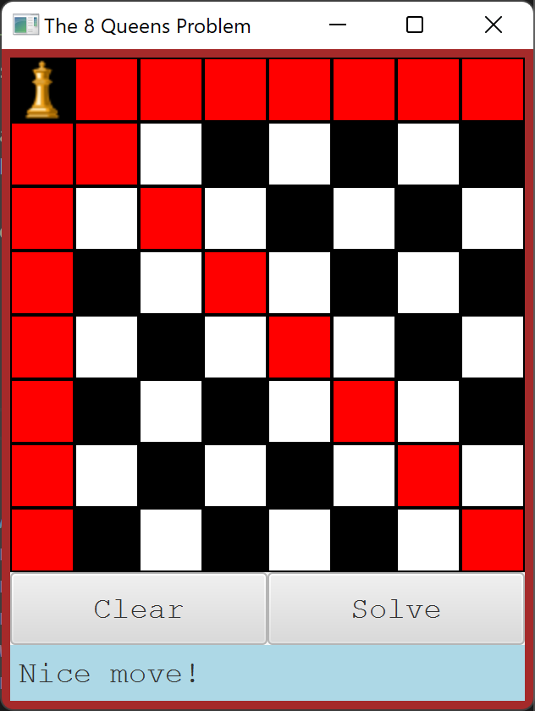
13.25
The N Queens Problem
Before designing a backtracking algorithm to solve the N-Queens problem, you should try it yourself! Your repository includes a JavaFX GUI that you can use to try to solve the N-Queens problem. Run the application now and see if you can solve the default configuration (8 queens).
You will find the queens.view.NQueensGUI application in your repository.
It is configured to launch with an 8x8 board by default.
Click to place a queen on any square. Click again to remove the queen.
Invalid squares are marked in red - you won't be able to place a queen there.
You may change the size of the board by closing the application, and launching with a command line argument.
Press the up-arrow in the terminal to recall the last command.
Type the size of the board after the command, e.g. 4, then press enter to run it.
Note that the "Solve" button is not yet implemented!

Slide 77
An Illustrated Example
There is a valid solution for the 8-Queens Problem.
There are actually lots of solutions.
Today we are going to design an algorithm capable of solving the N-Queens problem: placing N queens on an N*N chessboard.
(we should be able to find solutions for any N>3)

Slide 78
13.26
It's Good to be the Queen
Not surprisingly, the core of the N-Queens problem is the Queen class. Take a few moments to examine the code and ask any questions that you may have about the class.
We are not amused.
Open the "queens.model.Queen" class and examine the code inside.
You will see that a Queen is essentially a row, column location on the board and a few utility functions.
You should also note that instances of the class can be used in hashing data structures.
You will need to have a good understanding of the Queen class in order to use it to implement your backtracking algorithm. If you have any questions, now is the time to ask!

Slide 79
Backtracking Vocabulary
A configuration is an attempted solution at any stage.
A configuration is invalid if it breaks the rules of the problem being solved.
In the N-Queens problem this would be a chessboard with 0 or more queens placed on it.
In the N-Queens problem this would mean two queens can attack each other.
A successor configuration is one where one of the possible next choices has been made.
A configuration is the goal if it is a valid solution to the problem.
In the N-Queens problem, this would mean that an additional queen has been placed in an unoccupied square.
In the N-Queens problem this means N queens have been placed and no two can attack each other.

Slide 80
The Configuration Interface
We will be using a backtracking algorithm to attempt to find a solution to the N-Queens problem on chessboards of various sizes.
The first step in utilizing this algorithm is to create an implementation of the Configuration interface.
Remember that a configuration represents an attempted solution to a problem that includes the results of making zero or more choices.
The Configuration interface defines three required methods, the implementations for which will vary based on the problem being solved.
isValid() returns true if the configuration is valid. Which is to say it does not break the rules of the problem.
isGoal() returns true if the configuration is a valid solution to the problem.
getSuccessors() returns a collection of successors, each of which represents one of the possible next choices.
The class that implements Configuration must include the state needed to implement each of the required methods.
At first glance, the Configuration interface is deceptively simple. It only contains three methods, two of which return a boolean value.
1 public interface Configuration<C extends Configuration<C>> {
2 public boolean isValid();
3
4 public boolean isGoal();
5
6 public Collection<C> getSuccessors();
7 }
But, depending on the nature of the problem being solved, any one of them may be very challenging to implement.
The first step in implementing a Configuration that can be used to attempt to solve a problem using backtracking is to answer a few questions...
Notes:
This is a good time to mention that "Collection" is the parent interface for Lists and Sets.

Slide 81
A Closer Look at Implementing Configuration
public class TicTacToe
implements Configuration< TicTacToe > {
@Override
public Collection<TicTacToe> getSuccessors() {
List<TicTacToe> successors = new ArrayList<>();
return successors;
}
@Override
public boolean isValid() {
return true;
}
@Override
public boolean isGoal() {
return false;
}
}

Slide 82
A Closer Look at Implementing Configuration
As is common when implementing an interface, the methods are initially stubbed out.
Configuration is generic and the implementing class specifies its own type.
public class TicTacToe
implements Configuration< TicTacToe > {
@Override
public Collection<TicTacToe> getSuccessors() {
List<TicTacToe> successors = new ArrayList<>();
return successors;
}
@Override
public boolean isValid() {
return true;
}
@Override
public boolean isGoal() {
return false;
}
}
getSuccessors() should return a list of "next steps" towards possible solutions. Initially, the list will be empty.
This is similar to implementing Comparable.
isValid() should return false if the configuration breaks the rules of the problem. Initially it will return true.
isGoal() should return true if the configuration is a valid solution to the problem. Initially it will return false.

Slide 83

A Few Questions
Before you can begin implementing an algorithm that uses backtracking to solve a problem, you must answer a few questions about your configuration implementation.
First, how will you represent the state of a configuration?
What data structures are needed?
What other fields?
How will you construct a new configuration?
Second, how will you determine whether or not your configuration is valid?
How do you know whether or not the configuration breaks the rules of the problem?
Will this require additional fields or data structures?
Next, how will you determine whether or not the configuration is the goal?
Do you have a way to determine that it is a valid solution to the problem?
Finally, how will you create successors to your configuration?
Each will represent one of the possible next choices.
Before I can begin implementing a configuration, I need to understand what information I need.
Answering these questions before you attempt to implement a configuration can help avoid wasting a lot of time on false starts.

Slide 84
13.27
A Few Questions
Think about how you would approach implementing a Configuration for solving the N-Queens problem using backtracking. Take a few moments to consider each of the following questions. Answer them in a file named "queens.txt".
How will you represent the state of a configuration? What fields and constructors will be needed? | How will you determine if a configuration is valid or not?
How will you determine whether or not a configuration is the goal? | What do the successors of each configuration represent? How will you create them?

Slide 85
13.27
A Few Questions
Think about how you would approach implementing a Configuration for solving the N-Queens problem using backtracking. Take a few moments to consider each of the following questions. Answer them in a file named "queens.txt".
How will you represent the state of a configuration? What fields and constructors will be needed? | How will you determine if a configuration is valid or not?
How will you determine whether or not a configuration is the goal? | What do the successors of each configuration represent? How will you create them?
The queens that have been placed
The number of queens placed?
The last move made?
Do we need a chessboard?!
Does the canAttack method return true for any pair of queens?
It is valid
N queens have been placed on the board
The set of next possible moves
Create one for every empty square on the board?

Slide 86
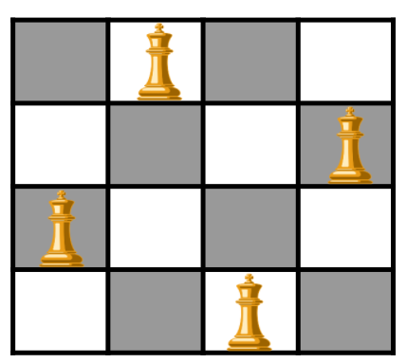
13.28
Implementing a Configuration
Implementing a solution to the N-Queens problem will require us to write an implementation of the Configuration interface that can be used with the Backtracker. Let's begin by creating a class and stubbing out the required functions.
Create a new Java class named "NQueens" in the queens.model package.
Implement the Configuration interface. You will find it in the backtracker package. Remember that it is generic. Your implementation should specify its own type in place of the type parameter, similar to implementing Comparable.
Stub out the required methods.
Add any fields that you think that you will be needing.
Add an initializing constructor.
Add a toString() that prints the configuration to standard output.
You don't need to do anything fancy.
Define a main method with the appropriate signature.
Create an instance of your class representing an empty 4x4 chessboard.
Print the configuration to standard output.
For any given value of N>3 there are multiple possible solutions.

Slide 87
What is a Successor, Anyway?
Each configuration represents an attempt at a solution to the problem after 0 or more choices have been made.
Let's take a look at an extremely simple version of the N-Queens problem: "Can 2 queens be played on a 2x2 chessboard?"
It's immediately obvious to humans that there is no solution to this problem, but a computer will need to use trial and error to figure that out.
The initial configuration represents a 2x2 chessboard on which no queens have yet been played.

Slide 88
What is a Successor, Anyway?
A successor is a new configuration that includes all of the choices made by its parent plus one additional choice.
We could say that there are four such potential choices that can be made on an empty chessboard.
But for now, let's focus on choices in just the top row on the board. On such a small board, there are only two such choices.
Each of these choices is a successor of the original configuration with one additional choice made.

Slide 89
What is a Successor, Anyway?
The goal of this problem is to see if there is a way to play two queens on the 2x2 board.
Neither successor is the goal, but neither is invalid, and so the backtracking algorithm will choose one and ask it for its successors.
We will avoid wasting time by trying to play another queen in the top row. Instead, we will create a successor for each of the possible moves in the bottom row.
Both of these are invalid configurations with illegal moves. These are dead ends.

Slide 90
What is a Successor, Anyway?
At this point, the algorithm will backtrack to a previous, valid configuration and use it to create another collection of successors.
Once again, each successor contains the same state as its parent configuration plus one additional move in the second row.
Also once again, both configurations are invalid.
At this point the algorithm has exhausted all possible configurations without finding a goal. There is no solution to this problem.

Slide 91

Deep Copies
Each configuration needs to store the queens that have already been placed on the board in some kind of data structure.
As you should know by now, all data structures (including arrays) are reference types.
If a function declares a parameter of an array type, a reference to the array is passed into the function.
Any changes made inside the function persist!
This includes constructors!
This means that if a configuration simply passes its array of queens into each of its successors through the constructor, they will all share the same array.
Any new moves made will overwrite each other, or add additional (potentially invalid!) queens to the board.
In order to avoid this problem, a deep copy of the data structure must be made.
This includes making a new array of the required size and copying all of the elements into the new array before giving the copy to a successor.
The same will need to be done with any mutable reference type that is used by a configuration.
Data structures like arrays are reference types. When used as an argument to a function, a reference to the real object in memory is passed in.
0 | 1 | 2 | 3 | 4 | 5 | 6 | 7
This means that any changes made to the reference will be made to the single, shared copy.
In the N-Queens problem, this means that successor configurations will add queens to the same array that is used by the parent and even overwrite each other's queens!!
A deep copy of the array must be made for each successor to prevent this from happening.

Slide 92

The most common error that students make when implementing a backtracking configuration is forgetting to make deep copies!
MAKE DEEP COPIES OF:
- Arrays
- Data Structures
- Mutable classes
- Everything!
If your configuration makes changes to some mutable value, e.g. adding queens to an array, it must have its own copy!
Otherwise, two different configurations will change each other's data!

Slide 93
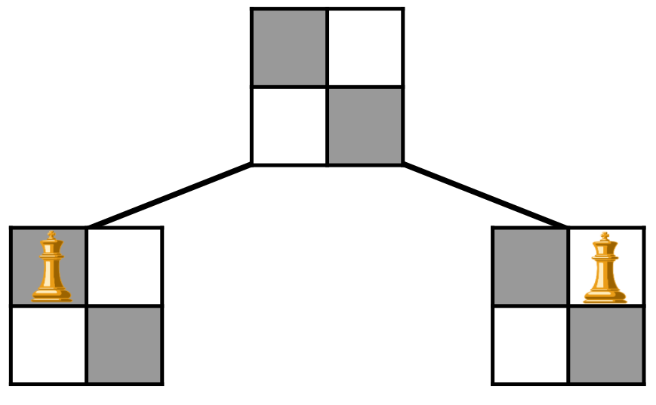
13.29
Lines of Succession
A successor to an NQueens configuration includes one of the next possible moves that can be made on the chessboard. For now, we will just focus on playing one queen in each of the available squares in the next row.
Open the NQueens class and implement the getSuccessors() method.
Don't waste time trying to place queens in the same row as the last queen that was played.
What if no queen has been played yet?
Generate a successor for each possible move in the next row.
This means that you should make N successors.
Hint: Use the Arrays.copyOf() method to make a deep copy of your array of queens with room enough for one more queen.
Be sure to make sure that you are not already in the last row!
Test your getSuccessors() function from main.
There should be four successors on a 4x4 board, all in the top row. Print each of the successors.
There should be one possible move for each successor in the next row.
If the board is empty, the "next" row is the first row.

Slide 94
Pruning
The 2-Queens problem is a fairly trivial instance of N-Queens that very quickly runs out of moves.
It just so happens that the last moves made always result in invalid configurations.
Consider a larger chessboard where there are many more possible choices that can be made at each iteration.
Your configuration may create an invalid successor long before the number of possible choices is exhausted.
Is there any way for an invalid configuration to lead to a valid solution?
Depending on the number of possible choices that have to be tested, a backtracking algorithm can be extremely computationally intensive.
You should try to optimize in any way you can to reduce the amount of time that it takes to find a solution.
One optimization technique is called pruning.
If a configuration is invalid, no additional successor configurations are tried from that point.
This branch of the search tree is abandoned.
Pruning is built into the backtracker.
If the isValid() method returns false, that configuration and all of its potential successors are pruned.
On larger boards it is not only possible, but very likely that your algorithm will create an invalid successor long before making every possible move.
It is impossible for a valid solution to be reached after a single bad placement of a queen. And so there is no sense in wasting time continuing to create successors after this point.
The backtracking algorithm that we will be using will automatically prune the search tree whenever it finds an invalid configuration.

Slide 95
13.30
Validating a Configuration
An N-Queens configuration is valid if no two queens have been played that can attack each other. Assuming that all previous configurations have been valid, which queen(s) do we need to look at closely? Which can we ignore?
Open the NQueens class and implement the isValid() method.
You should return true if none of the queens played (so far) can attack each other.
Do you need to compare every pair of queens?
Test your method by calling it from main.
It should return true for an empty board. This is fine for now.
The isValid() method is only concerned with whether or not any two queens can attack each other.
But does it have to check them all?

Slide 96
13.31
Gooooooooooooal!
An N-Queens configuration is the goal if it is valid (no two queens can attack each other) and all N-Queens have been placed on the chessboard. Implement this functionality in your N-Queens configuration now.
Open the NQueens class and implement the isGoal() method.
If the configuration is valid, and N queens have been placed on the chessboard, return true.
Otherwise, return false.
Test your isGoal() function from main.
It should return false. This is good enough for now.
For any board larger than 3x3 there are multiple possible solutions. The one that the backtracker finds depends on the order in which moves are made.

Slide 97
The Backtracking Algorithm
Now that we have an implementation of the Configuration interface, it can be executed using a simple, generic backtracking algorithm to solve the problem.
Call the solve method with a configuration C:
If C is the goal, then return C. Problem solved!
Otherwise, for each of C's successors S:
If S is valid, recursively call solve with S
If a non-null solution is returned, problem solved! Return the solution configuration!
If none of C's successors returns a non-null solution, then there is no solution from C. Return null.
The backtracking occurs whenever one of C's successors fails to return a solution.
The algorithm backtracks to C and then moves on to its next successor.
An implementation of this algorithm has been provided to you in the Backtracker class.
You can create a Backtracker with or without debugging enabled.
The solve() method will work with any class that implements Configuration.
public C solve(C config) {
if(config.isGoal()) {
return config;
} else {
for(C child :
config.getSuccessors()) {
if(child.isValid()) {
C sol = solve(child);
if(sol != null) {
return sol;
}
}
}
}
return null;
}
Note that the Backtracker is also generic and declares a type parameter C. This must be replaced with a real class that implements Configuration.
The Configuration returned may be null if no solution is found.

Slide 98
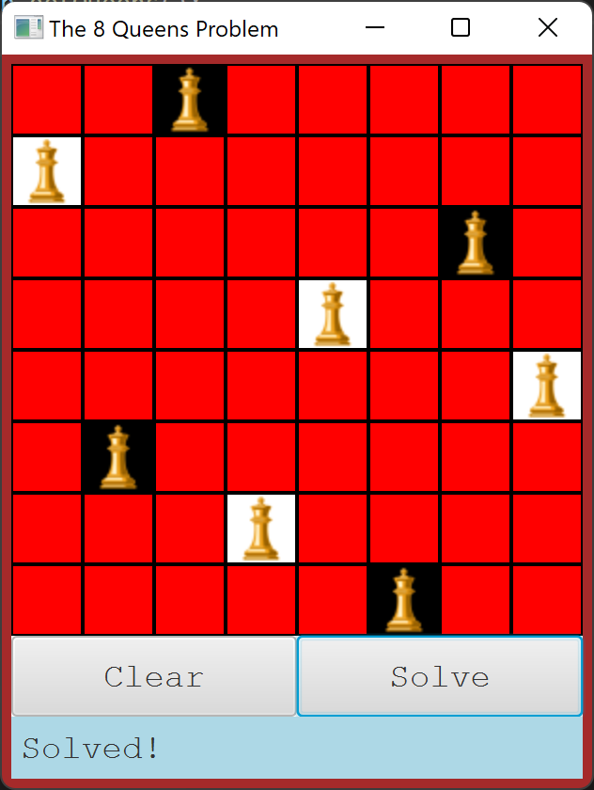
13.32
Plug in the Backtracker
The "solve" method in the NQueens GUI has been commented out. If your backtracking configuration is ready, you can uncomment the code and try it out!
Open the NQueens class and implement a getQueens() method that returns the array of queens.
Open the NQueensGUI class and navigate to the solve method at the top of the class.
Uncomment the code there.
You will need to import the classes required to use the backtracker and your configuration.
Take a few moments to examine the code, and ask any questions that you may have!
Run the application and try it out!
Press solve right away.
Try placing a few queens first. You will need to place them top-to-bottom starting with the first row.
Can you find a set of moves that is unsolvable?
Try running with different board sizes. How long does it take to solve for 16 queens? 20?

Slide 99


Summary & Reflection
What is one thing that you wish you knew more about as we move forward?
Algorithms
Pseudocode
Greedy Algorithms
Weighted Graphs
Weighted Edges
Traveling Salesman
Dijkstra's Algorithm
Backtracking
Configurations
The Backtracker
The N-Queens Problem
What is one new thing that you learned today?
What one question do you have about today’s class?
Please answer the questions above in your notes for today.

